Slide 1
Parallelizing Genetic Algorithm

Slide 2
Problem Statement
Given a target string, the goal is to produce target string starting from a random string of the same length. In the following implementation, following analogies are made :
Characters A-Z, a-z and other special symbols are considered as genes
A string generated by these characters is considered as chromosome/solution/Individual
Fitness score is the number of characters which differ from characters in target string at a particular index. So individual having lower fitness value is given more preference.

Slide 3
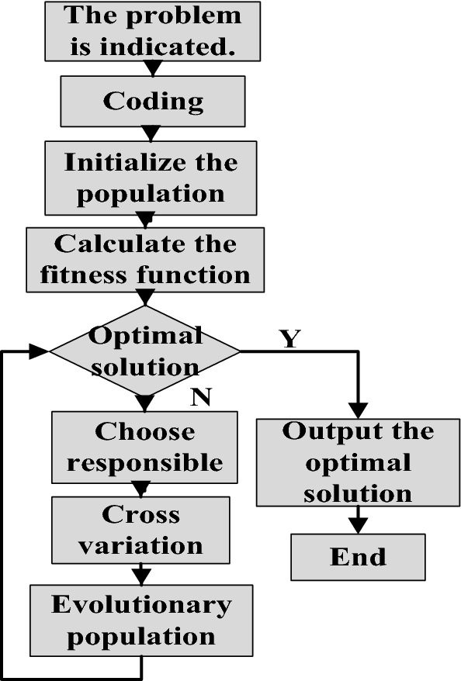
Block Diagram

Slide 4
Operations to parallelize
Population Initialization:
Population initialization in a genetic algorithm involves creating an initial set of potential solutions (individuals) to the problem at hand. These individuals, represented as chromosomes, are generated randomly or through specific methods. A diverse and representative initial population helps explore a broader solution space and increases the chances of finding optimal solutions.
Fitness Scoring:
Fitness scoring is the process of evaluating how well each individual in the population solves the problem by assigning a fitness score. This score reflects the individual's suitability or performance in the given task. Individuals with higher fitness scores are more likely to contribute to the next generation, promoting the evolution of better solutions over successive generations.
Crossover:
Crossover, also known as recombination or mating, is a genetic operator that combines genetic material from two parent individuals to create new offspring. In the context of genetic algorithms, crossover mimics the natural process of genetic recombination. By exchanging genetic information between parents, crossover introduces diversity and helps explore different combinations of solution components, enhancing the algorithm's ability to converge towards optimal solutions.

Slide 5
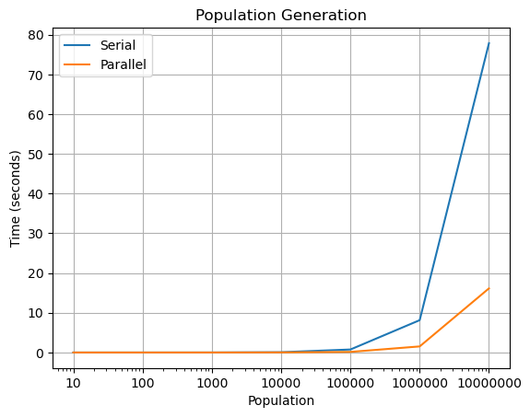
Parallelizing population generation
Create a population of individuals with the necessary string size
This can be parallelized simply by using openmp (#pragma omp parallel for)

Slide 6
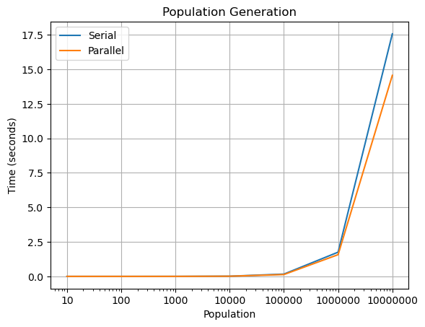
Parallelizing Fitness Scoring
Fitness scoring is the process of evaluating how well each individual in the population solves the problem by assigning a fitness score.
Since this is also a simple for loop this can be parallelized using openmp (#pragma omp parallel for)

Slide 7
Parallelizing Crossover
Crossover, also known as recombination or mating, is a genetic operator that combines genetic material from two parent individuals to create new offspring. We perform multipoint crossover for our application
This cannot simply be parallelized since we have to manipulate memory location.
APPROACHES TO PARALLELIZE:
We have to perform different algorithm or try using the arrays and pointers to make sure memory dependency is not an issue
We can assign a single thread dedicated to two individuals crossover alone so that memory dependency is avoided.

